Slide 1


Causal inference of multivariate server performance logs
Kewei Zhang
2024/02/20

Slide 2
Introduction
Data monitoring and visualization
Datadog
Causal Inference
Data Imputation
Stationary Transformation
Correlation Analysis
Causal and Inference

Slide 3
Data Monitoring and Visualization
Datadog
Logs Dashboard | Datadog (datadoghq.com)

Slide 4
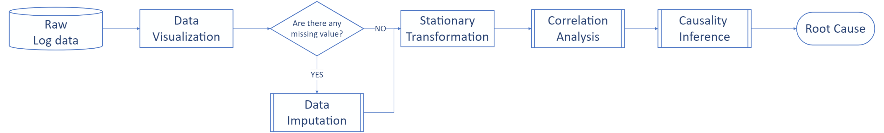
Causal Inference
Establish whether and how changes in one variable cause changes in another
Example: Processor Time – Performance Counter (Instance: RapidResponse)

Slide 5
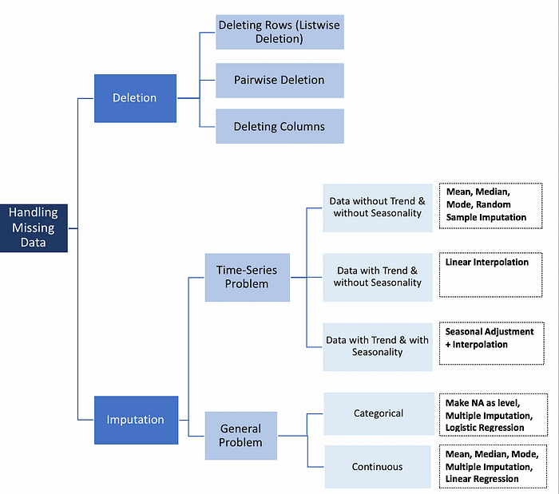
Data Imputation
Imputation for missing value to generate complete datasets

Slide 6
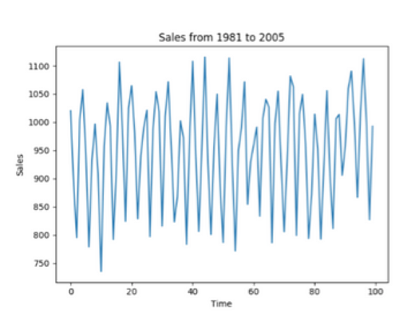
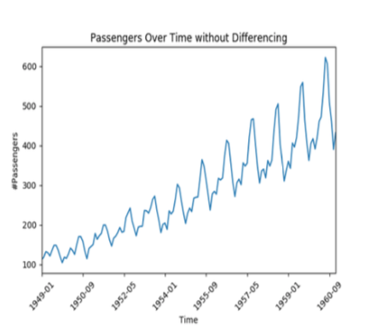
Stationary Transformation
Why stationary is important: most time series models assume that each point is independent of one another.
Stationary data: mean and variance do not vary across time
Stationary data
Non-stationary data

Slide 7
Correlation Analysis
Evaluate strength and direction of the linear relationship between two variables
Question: We can only retain a month's worth of data, insufficient for any computation
Solution: Employ a variety of mathematical computations
Method:
Pearson correlation coefficient
Spearman correlation coefficient
Kendall correlation coefficient

Slide 8
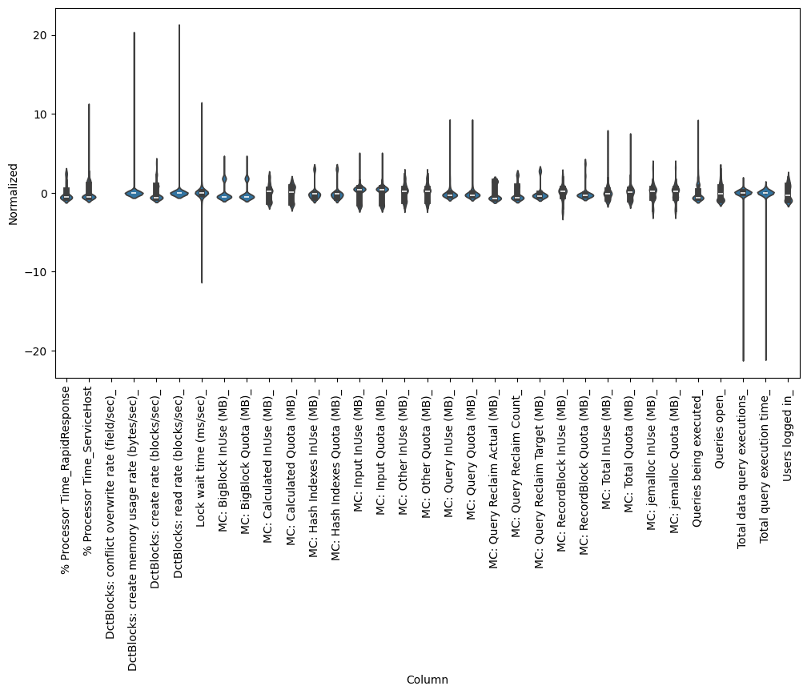
Correlation Analysis

Slide 9
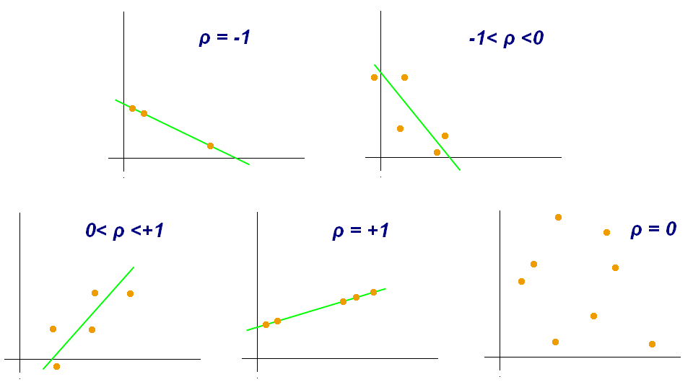
Correlation Analysis
Pearson Correlation Coefficient: [-1,1]
Coefficient = 1 or -1: perfect linear relationship
Coefficient = 0 : no linear relationship, could have a non-linear or more complex relationship
perfect negative correlation
negative correlation
positive correlation
perfect positive correlation
no liner correlation

Slide 10
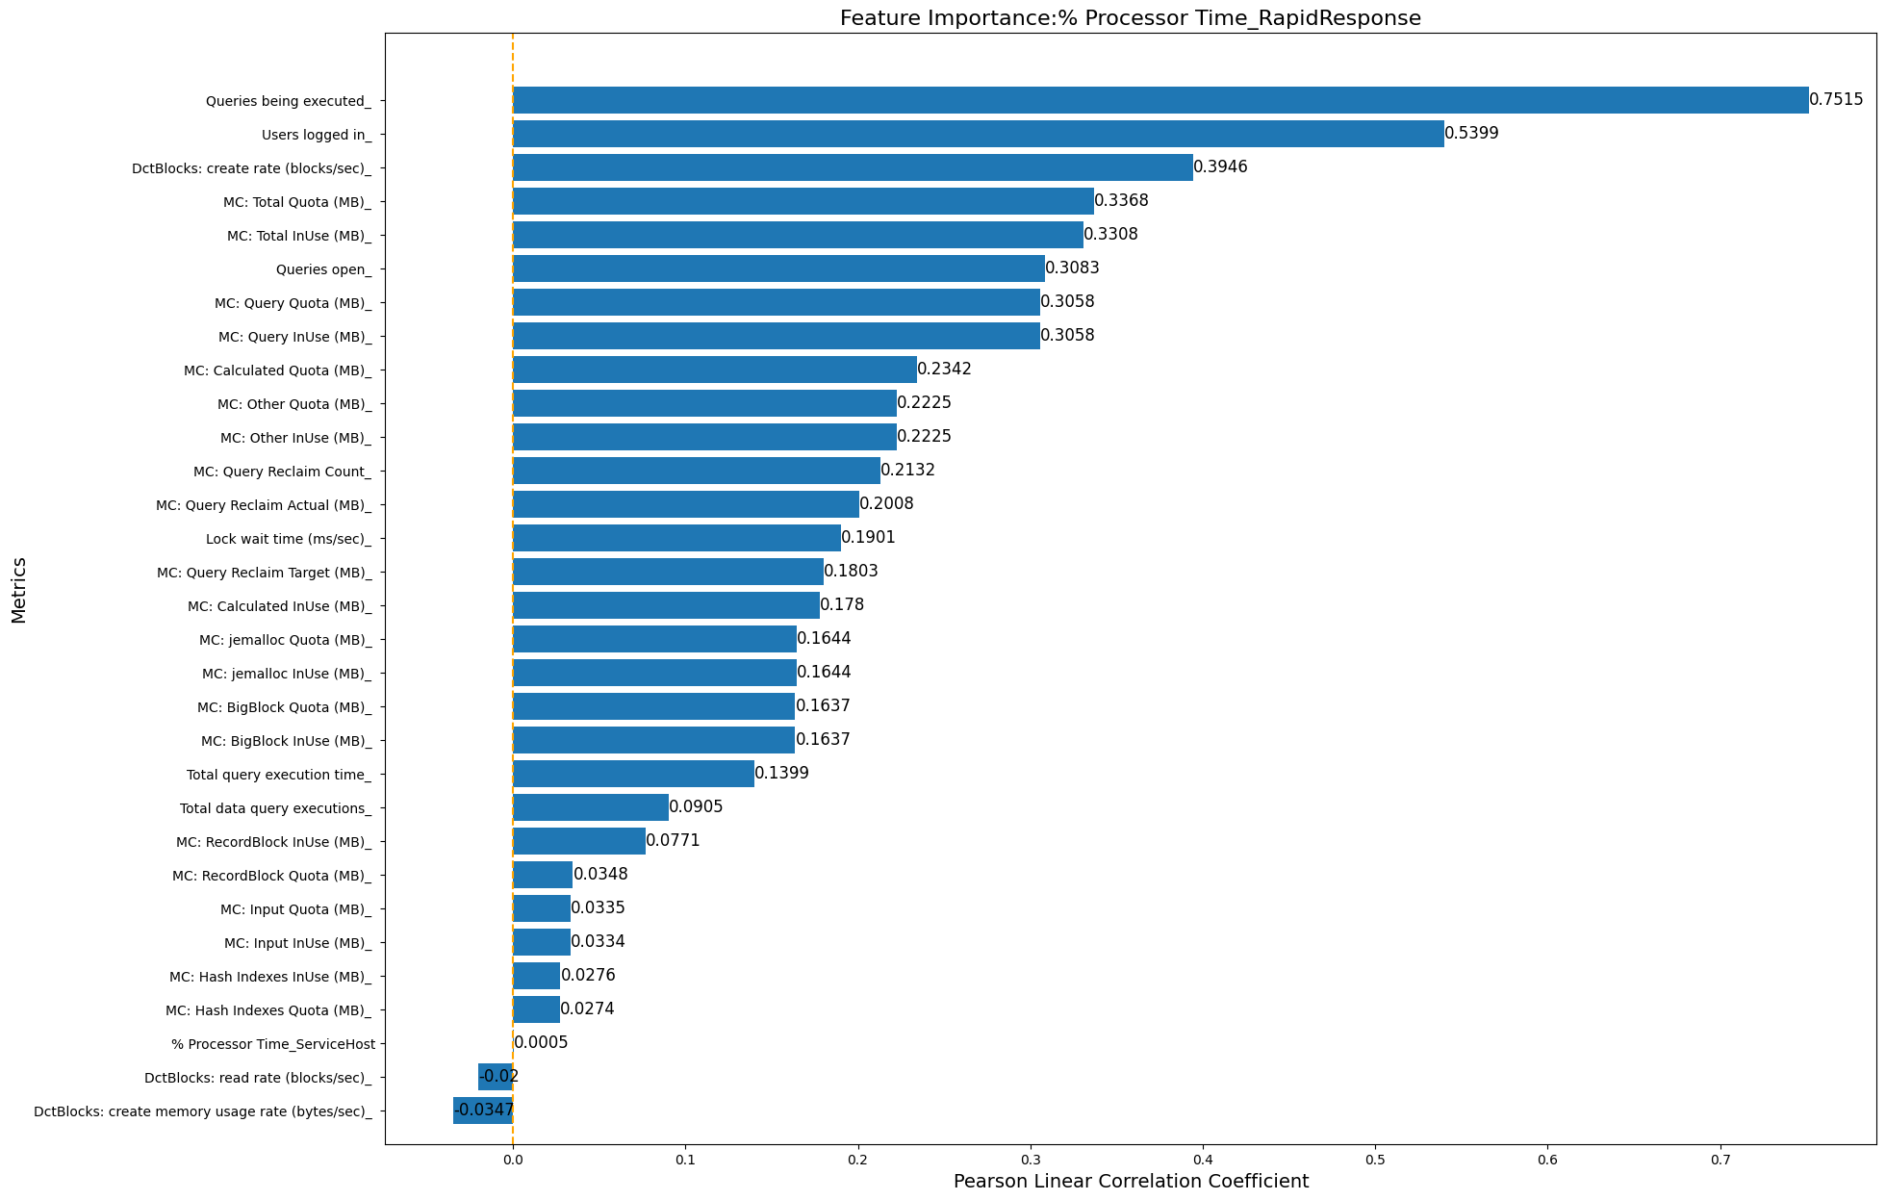
Pearson Correlation Coefficient

Slide 11
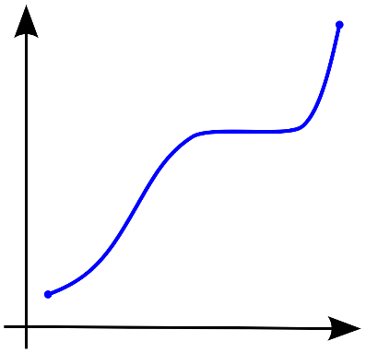
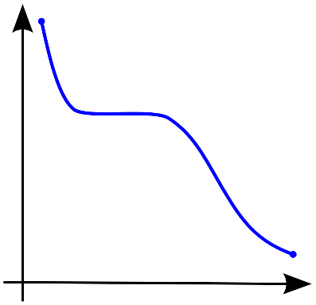
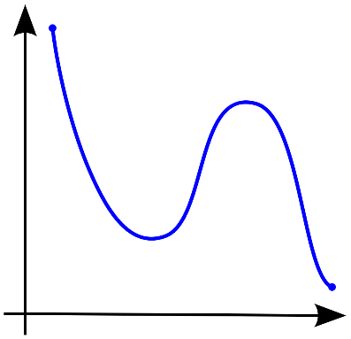
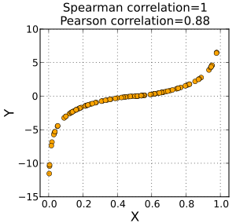
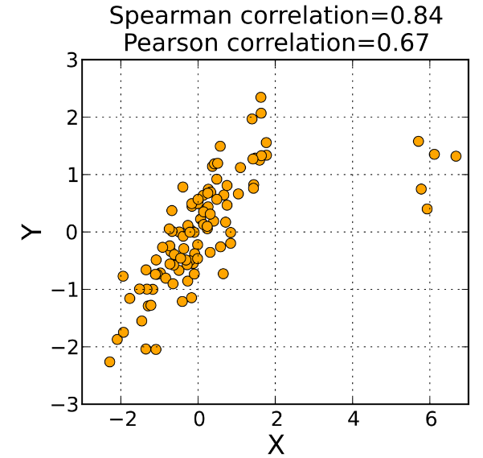
Correlation Analysis
Spearman Correlation Coefficient
coefficient = 1/-1 : perfect positive/negative monotonic relationship
Coefficient = 0 : no monotonic relationship
Monotonic
non-decreasing
Monotonic
non-increasing
Not monotonic

Slide 12
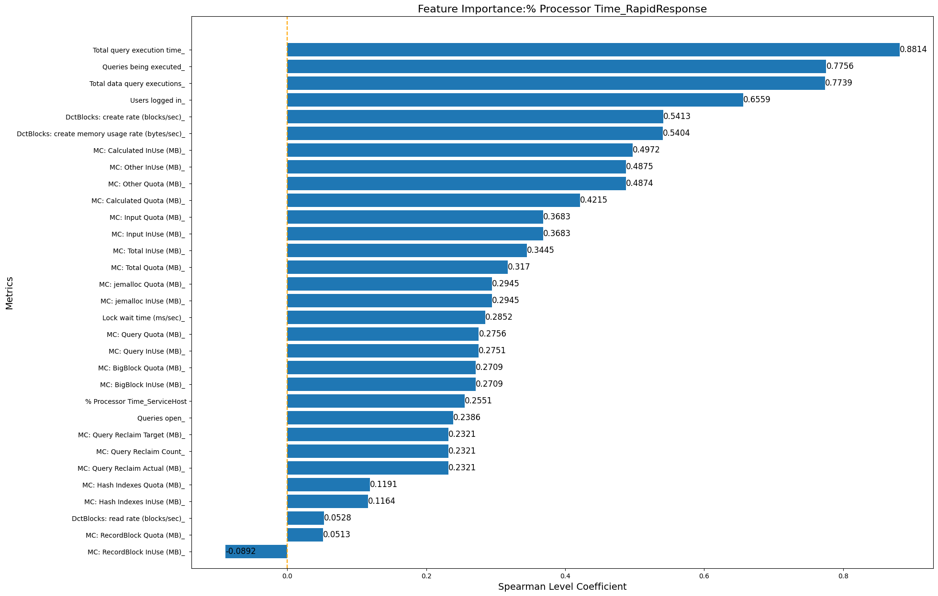
Spearman Correlation Coefficient

Slide 13
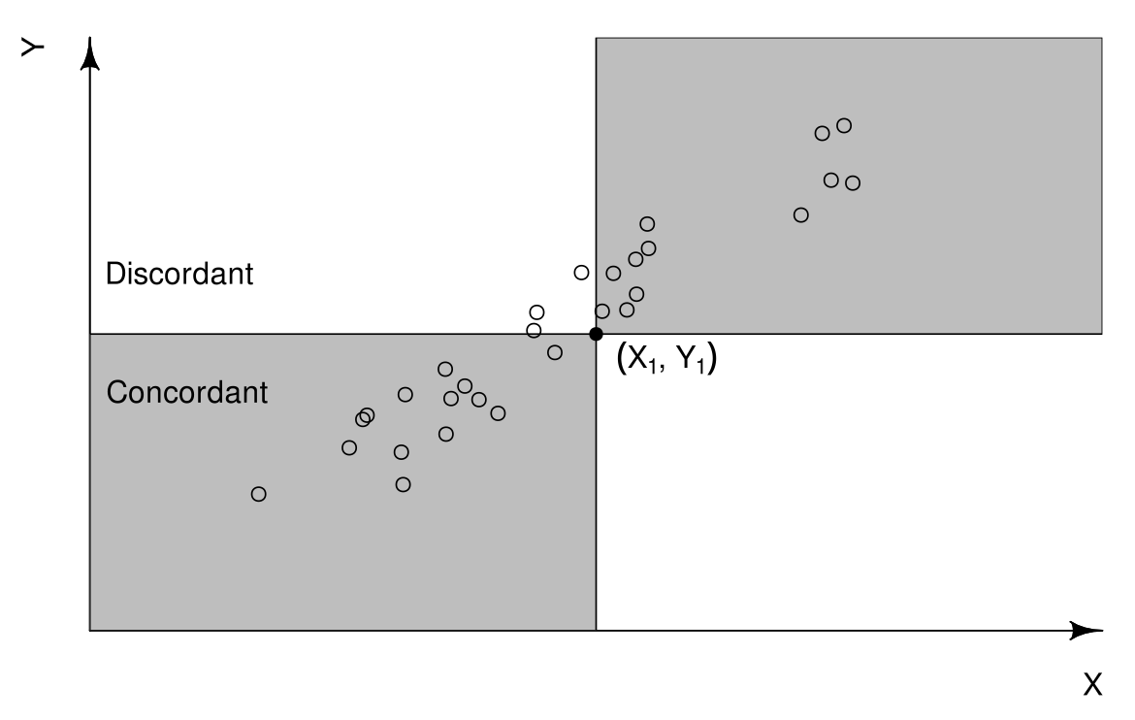
Kendall Correlation Coefficient
coefficient = 1/-1: ranks of corresponding values within each data sample always same
Coefficient = 0 : no association between the ranks of the values
Ex: (xi,yi), (xj,yj), i < j:
Either both xi > xj and yi > yj or xi < xj, yi < yj

Slide 14
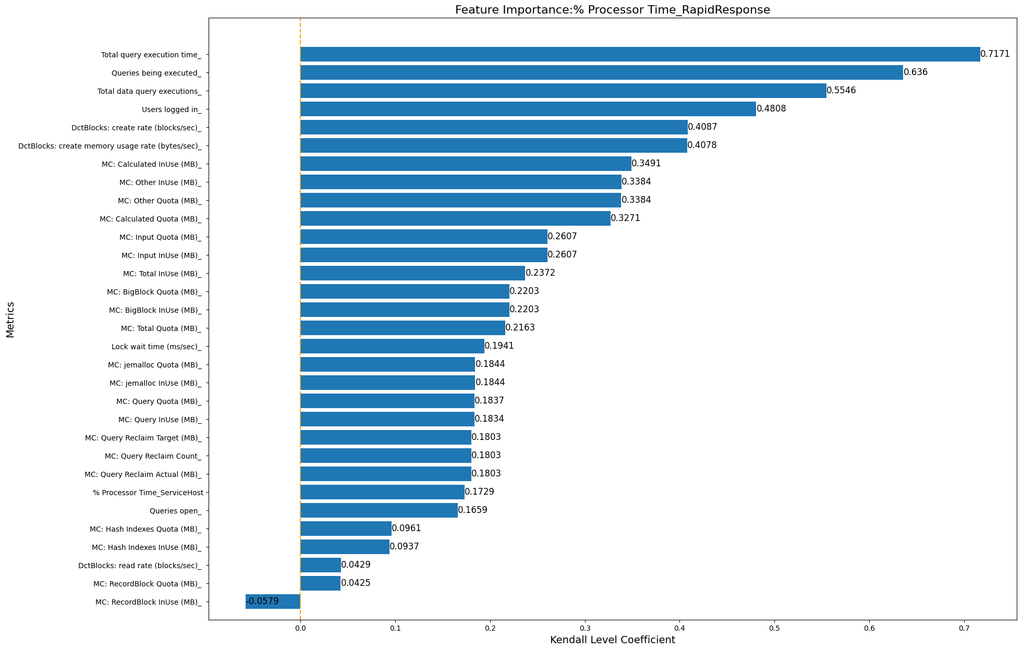
Kendall Correlation Coefficient

Slide 15
Correlation Coefficient
Top5 Results:
Pearson Correlation:
Queries being executed
Users logged in
DctBlocks: create rate (blocks/sec)
MC: Total Quota (MB)
MC: Total Inuse (MB)
Spearman Correlation:
Total query execution time
Queries being executed
Total data query execution
Users logged in
DctBlocks: create rate (blocks/sec)
Kendall Correlation:
Total query execution time
Queries being executed
Total data query execution
Users logged in
DctBlocks: create rate (blocks/sec)

Slide 16
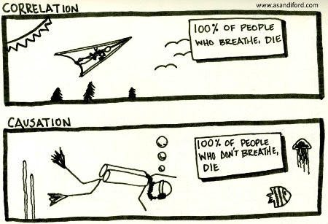
Correlation VS Causation

Slide 17
Transfer Entropy
Features of time series: max, min, mean, median, variance,…
Series A : 1, 2, 1, 2, 1, 2, 1, …
Series B : 1, 1, 2, 1, 2, 2, 1, …
Same mean, same variance, same median, different entropy
Larger the entropy, more chaotic the system
Transfer entropy: transfer of information

Slide 18
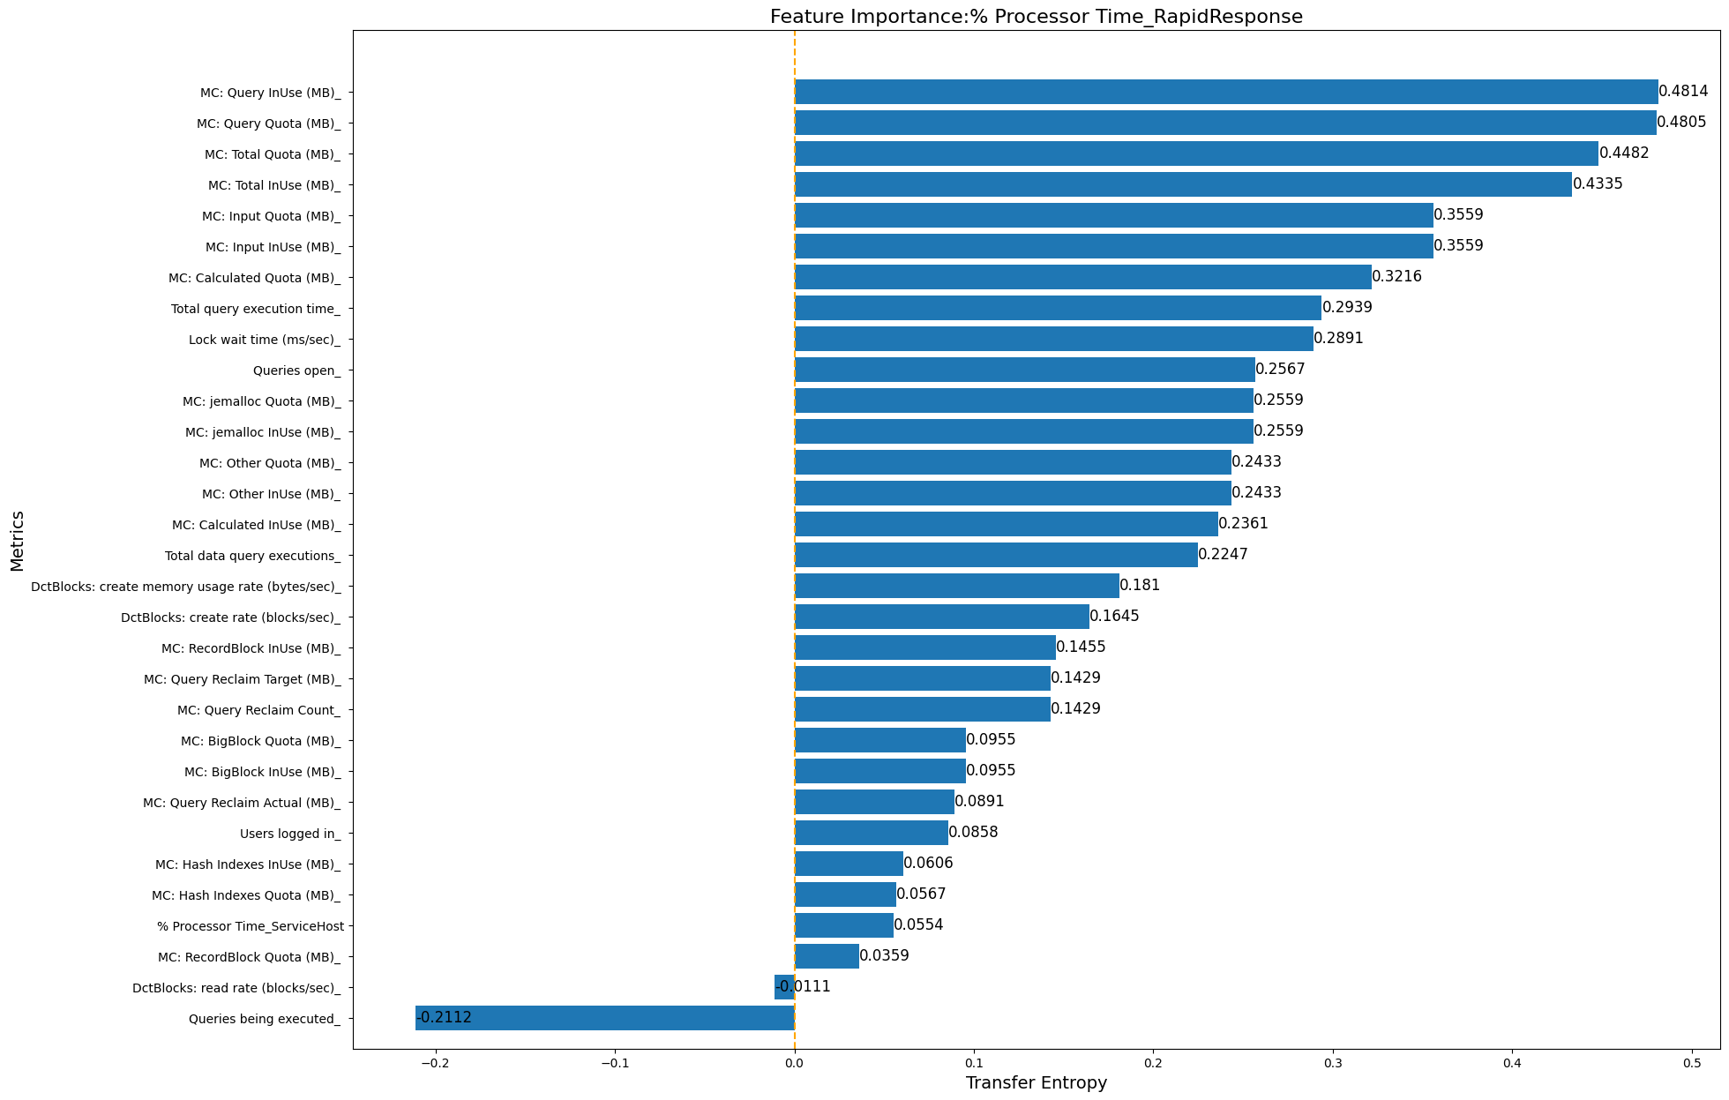
Causal Inference
Transfer Entropy
Symbol: direction of transfer
+:Y -> X
-: X -> Y

Slide 19
Causal Inference
Causal Inference
Neural Network: LSTM(Long-short term memory)
Step 1: Forecasting
Step 2: Evaluating the prediction model
Step 3: Calculating feature Importance

Slide 20
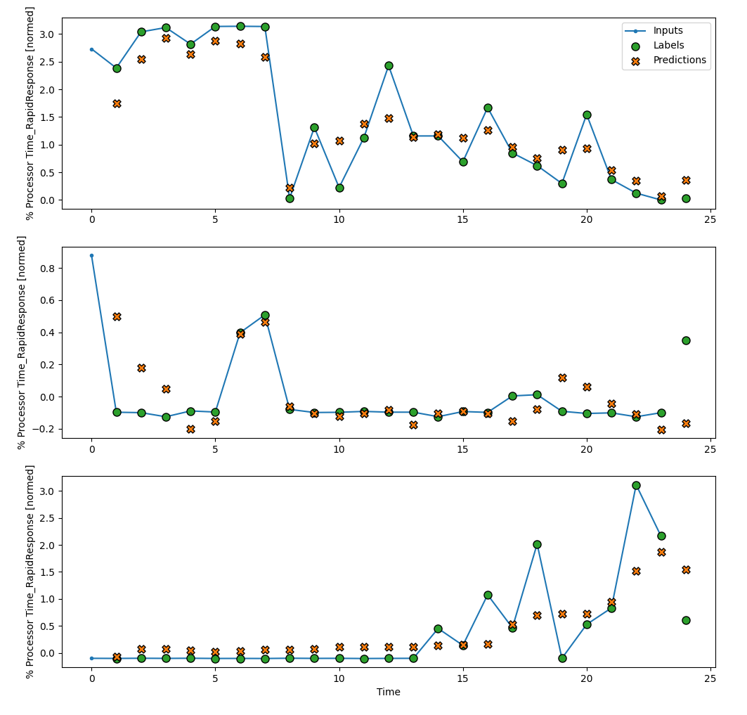
Causal Inference
Step1: Forecasting
Selected 3 subsections from the entire dataset as examples

Slide 21
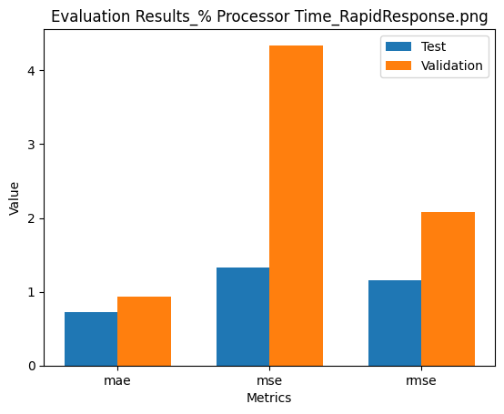
Causal Inference
Step 2: Evaluating the prediction model
MAE: mean absolute error
MSE: mean squared error
RMSE: root mean squared error

Slide 22
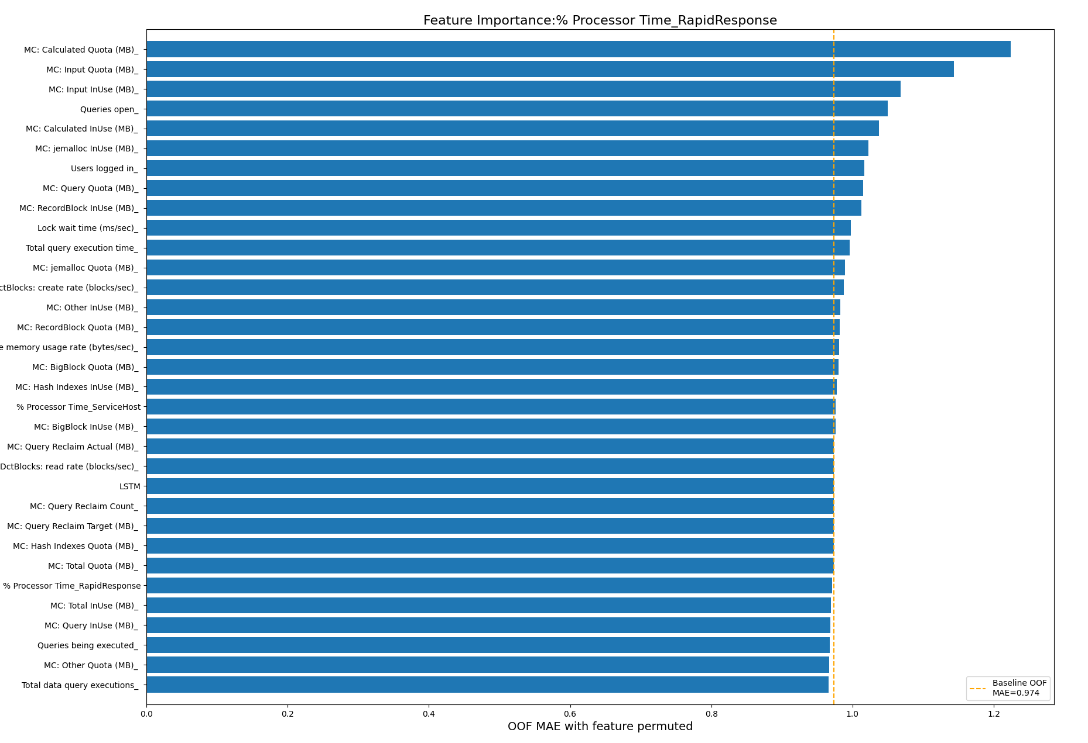
Causal Inference
Causal Inference
Step 3: Calculating feature Importance
OOF: Out-of-Fold, dividing a dataset into subsets, known as “folds.” Each fold is then used as a validation set once while the remaining folds are utilized for training.

Slide 23
Conclusion
Most Correlated metrics with Processor Time:
Total query execution time
Queries being executed
Total data query execution
users logged in
DctBlocks: create rate (blocks/sec)
Metrics with the largest Transfer Entropy:
MC metrics
Total query execution time
Lock wait time
Queries open
Total data query execution
Metrics with the biggest influence:
MC metrics
Queries open
Users logged in
Lock wait time
Total query execution time

Slide 24
Conclusion
Possible Reason of error:
Insufficient data
Inappropriate model selection
Not suitable
Overfitting: too complex neural network model
Underfitting: complex topological structure
Feature engineering issues
Incorrect stationary transformation

Slide 25
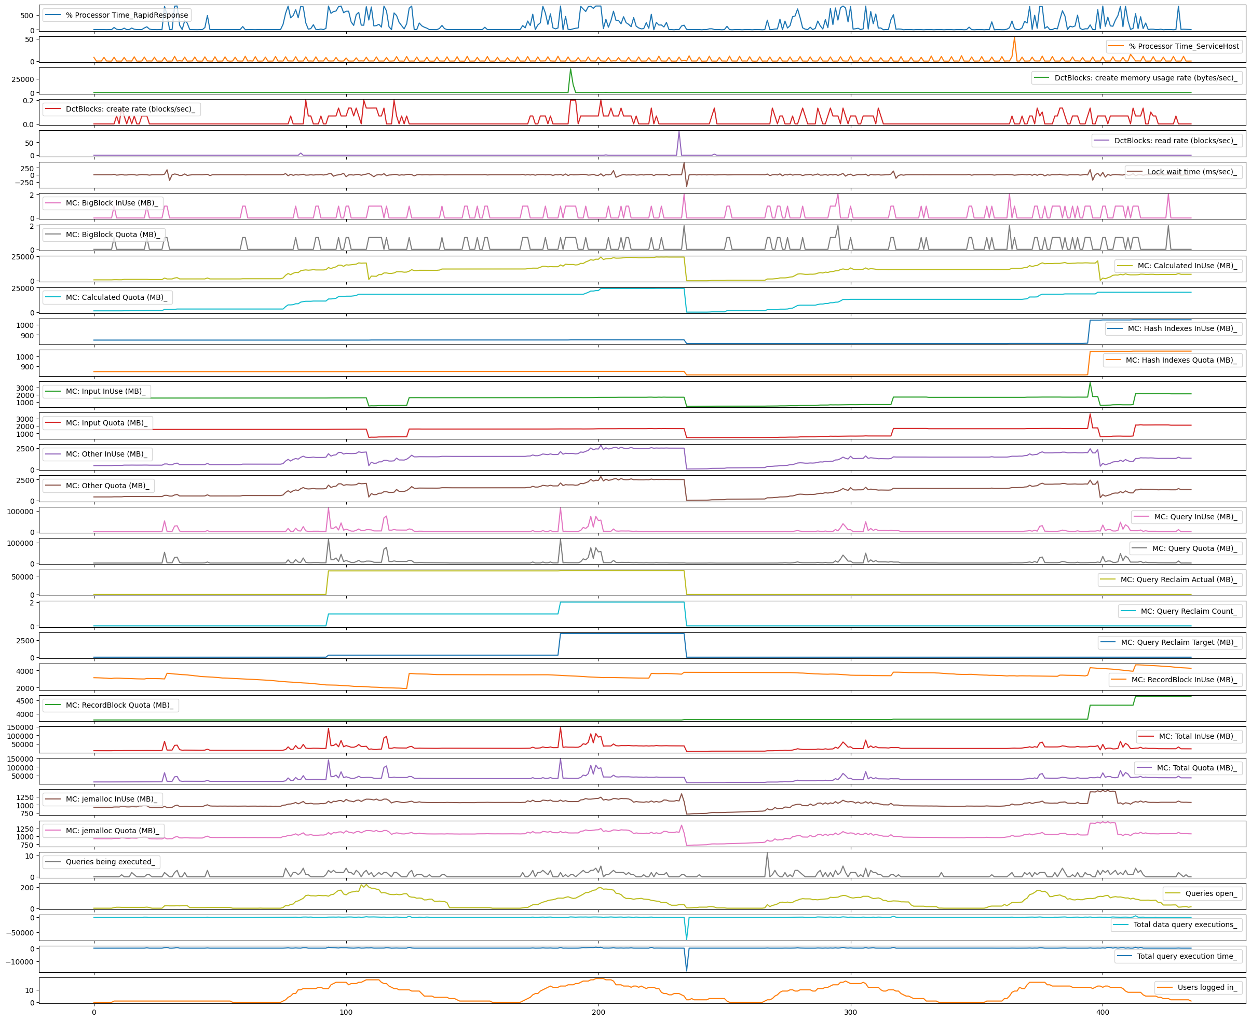

Slide 26
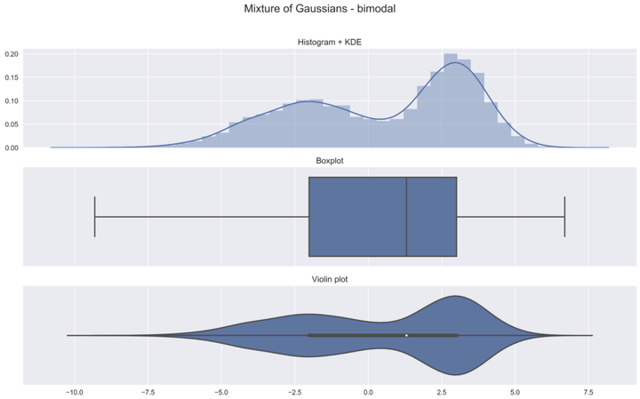
Correlation Analysis
median
quartile
quartile
adjacent value
adjacent value
outside points
outside points

Slide 27
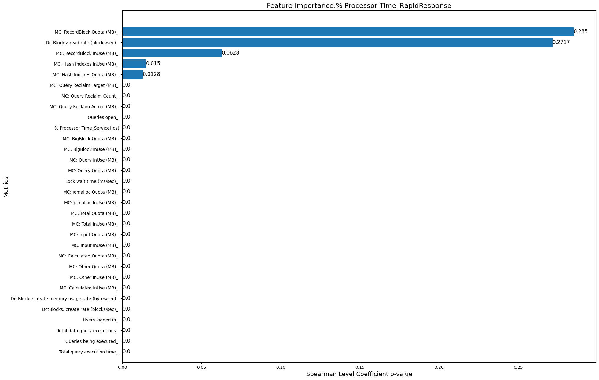
Spearman Correlation Coefficient P-value
Spearman Correlation P-value:
p-value > 0.05: The correlation is not statistically significant, means that the observed correlation could plausibly have happened by chance alone

Slide 28

Correlation Analysis
Kendall Correlation P-value:
p-value > 0.05: The correlation is not statistically significant, means that the observed correlation could plausibly have happened by chance alone

